Slide 1
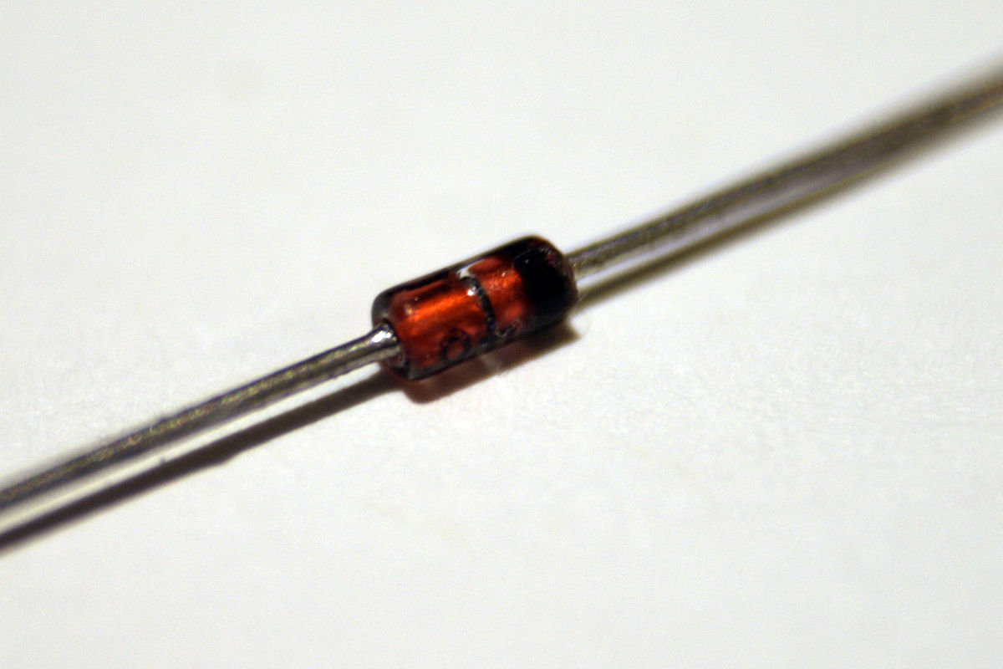
ZENER DIODE
Dr.A.ANBARASI,
ASSOCIATE PROFESSOR,
DEPARTMENT OF PHYSICS,
PERIYAR ARTS COLLEGE
CUDDALORE

Slide 2
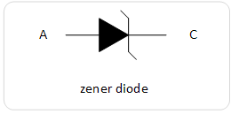
ZENER DIODE
A Zener diode is a special type of diode designed to reliably allow current to flow backwards when a certain set reverse voltage is known as the Zener voltage is reached.
Zener diode is manufactured with a great variety of Zener voltages and some are even variable.
* The diode consists of special heavily doped p-n junction
* It is designed to conduct in the reverse direction when a certain specified voltage is reached.
* Zener diode has a well-defined reverse-breakdown voltage at which starts conducting current.
* And continue operating continuously in the reverse mode without damaged

Slide 3
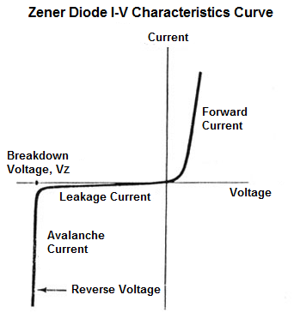

Slide 4
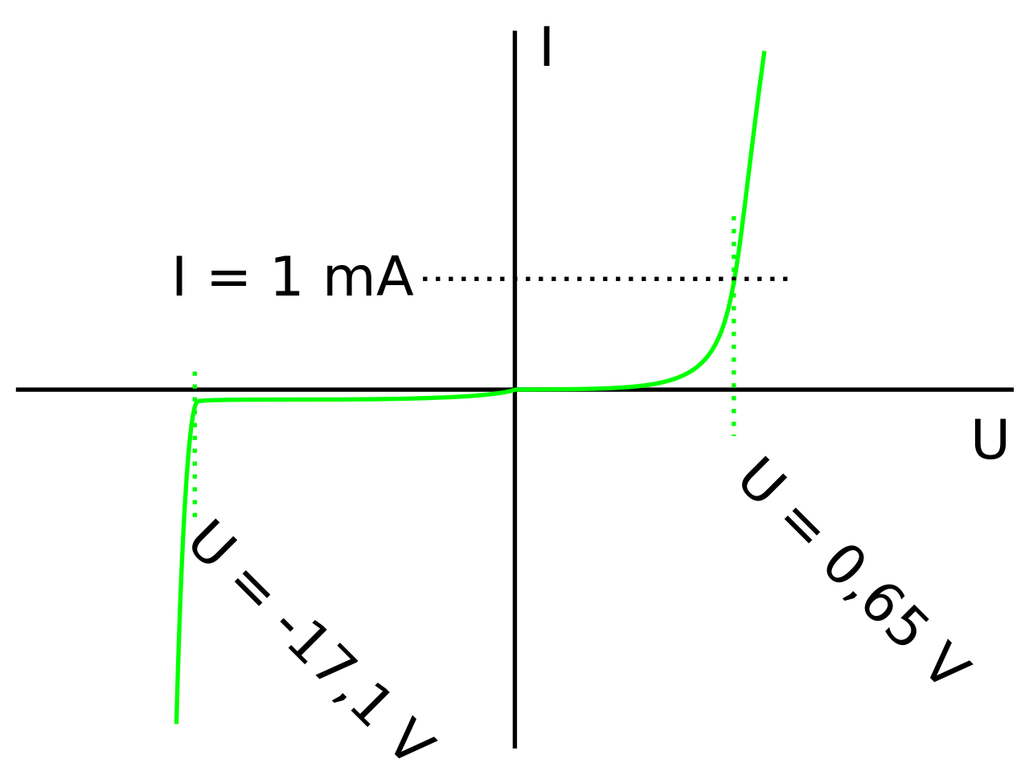

Slide 5
The voltage droACROSS THE DIODE REMAIN CONSTANT over a wide
range of voltages.
The Zener diode is suitable for use in voltage regulation.

Slide 6
ZENER DIODE OPERATION
The Zener diode operates like the normal diode when in the forward-bias mode
And has turn-on voltage of 3.0 and 0.7V
When connected to reverse mode which is mostly used in various applications (i.e. small leakage current flow).
The current increases to a maximum, which is determined by the series resistor. After it is stabilizes remains constant over a wide range of applied voltages.

Slide 7
ZENER BREAKDOWN
The breakdown due to Zener breakdown effect that occurs below 5.5V
Each mechanisms has a different temperature co-efficient.
The Zener effect has a negative temperature co-efficient while the impact of positive co-efficient.
ZENER DIODE SPECIFICATION
Such as normal working voltage, power dissipation, maximum reverse current.

Slide 8
PIN DIODES
A PIN diode is a diode with a wide undoped intrinsic semiconductor region between a P-type and N-type semiconductors region .
P-type and N-type region are heavily doped because of their ohmic contacts
Mostly used in attenuators, fast switches, photodetectors, and high voltage power electronics application.

Slide 9
PIN diodes also called high level injection.
I region is flooded with charge carriers from the P region and N region’
For example, filling up the water bucket with a hole on the side.
Electric field helps in speeding up of the transport of charge carriers from P side to N region.
This device is used for high frequency operations.

Slide 10
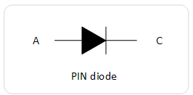
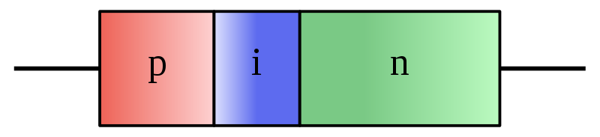

Slide 11
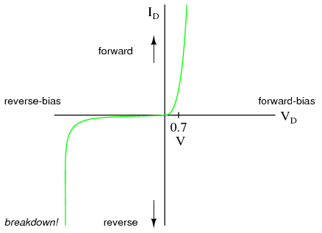

Slide 12
CHARACTERISTICS OF PIN DIODE
PIN diode obeys the standard diode equation for low frequency signals.
PIN diode is relatively large stored charge in a thick intrinsic region.
At low frequency the stored charges leads to diode turn off.
Reverse recovery time also fixed.

Slide 13
PIN diode is also act as a variable resistor i.e. the frequency region range is (from .1 ohm to 10 k ohm)
The wide intrinsic region acts as a low capacitance when reverse-biased.
Increasing the thickness of the intrinsic region increases the stored charges and decreasing the RF resistance’
Variety of geometric specific RF bands and uses.

Slide 14
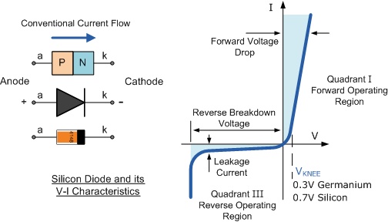

Slide 15
APPLICATIONS
PIN diode is used as an ideal radio frequency switch.
O and N layer increase spaces between them also reduces the capacitance between these region
High voltage power electronics.
Fast switches
Attenuators
Photo detectors
Used as a high voltage rectifiers
It mainly used in RF frequency application
It is mainly used in electronic projects.

Slide 16
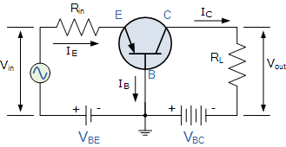
TRANSISTOR
The junction transistors are two types namely; p-n-p and n-p-n transistor
The transistors has the following sections.
EMITTER: this forms the left hand section of the region of the transistor.
The main function of this region is supply majority charge carriers(either electros or holes)
It is heavily doped comparison with other regions.
Electrons are the charge carriers within the n-p-n transistor.
Where the holes are the charge carriers within the p-n-p transistor.

Slide 17
BASE: The middle section of the transistor is called base.
This is very lightly doped and is very thin(10^-6) as compared to either emitter or collector .
So that it may pass most of the injected charge carriers to the collector.
COLLECTOR: The right hand side of the transistor is called collector.
The main function of the collector is to collect majority charge carriers through the base.

Slide 18
Working of p-n –p transistor
The emitter base junction is forward biased voltage the battery Veb.
The collector-base junction is reverse biase junction is reverse biased by the battery Vcb.
The directions of the emitter, base, and collector currents are shown in the figure.
The direction of each current is opposite to the direction of motion of the electrons.
The electrons are being the majority carriers are in the emitter are repelled due to forward bias towards the base.

Slide 19
The base contains holes as majority carriers and some holes and electron combine in the base region. Since the base is lightly doped, the probability of electron-hole combination in base region is very small(5%).
The remaining electrons cross into collector region, and enter into the positive terminal of the battery Vcb connected to the collector.
At the same time an electron enters the emitter from the negative pole of the emitter-base battery Veb.
Thus in n-p-n transistors, the current is carried inside the transistor as well as in the external circuit by the electros.
If Ie.Ib,and Ic are respectively the emitter current, the base and the collector current then Ie=Ib+Ic

Slide 20
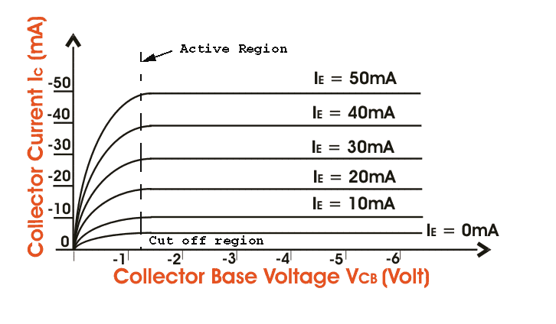

Slide 21
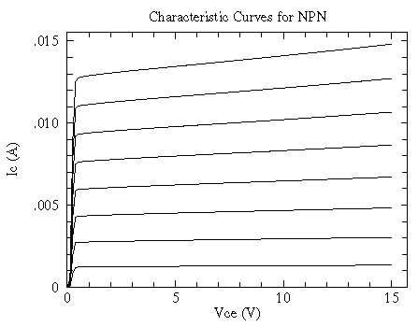
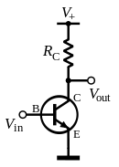
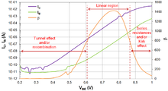
This Photo by Unknown Author is licensed under CC BY-SA

Slide 22
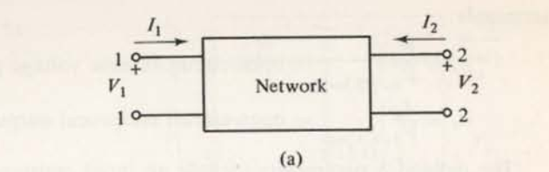
TWO PORT REPRESENTATION OF TRANSISTOR
Any linear circuit with four terminals can be regarded as a two port network.
A two port network is represented by four external variable.
Two inputs and two out puts.
Ie input voltage and input current
Out put voltage and out put current

Slide 23
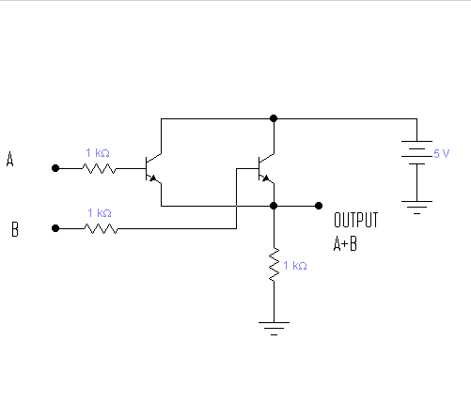
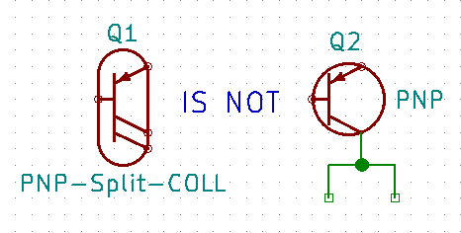
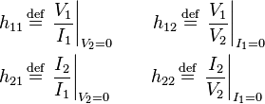
This Photo by Unknown Author is licensed under CC BY-SA

Slide 24
TWO-PORT REPRESENTATION OF A TRANSISTOR
A transistor having three terminals is an active device and can be used as a three configuration,CB ,CE,CC.
From these one of the terminal is common to input and output.
Therefore a transistor acts as a two port network,ie input port and output port.
For amplification purpose the signals (current,and voltages) are amplified.
The amplified signals are taken in to output port.
Therefore the transistor as a black box.

Slide 25

HYBRID PARAMETERS

Slide 26
THE HYBRID EQUIVALENT CIRCUIT
The h-parameter quivalent circuit is widely used for small signal low frequency application because the following reason.
The h-parameters can be measured easily.
They are more independent of each other and variables like frequency and operating points etc.
The h-parameters are real numbers at audio frequencies.
Particularly suitable for circuit analysis and design .
Specified by the transistor manufactuers.

Slide 27
HYBRID PARAMETERS
A four terminal network or a port network can be treated as a Black Box with two input terminals and two output terminals
Four variables can be related by the following equations:
V1=h11I1+h12V2 …………..(1)
I2=h21I1+h22V2 ………….(2)
The four parameters are h11,h12,h21,h22 which relate
Four variable of two port system are called h-parameters.
First putting V2=0
I1 becomes zero (I1=0) ie ouput terminals is short circuit, and input circuit is open circuited therefore the eqn.(1) and (2) becomes
h11= V1/I1 at v2=0

Slide 28
HYBRID PARAMETERS
V1=h11I1+h12x0………(3)
I2=h21I1+h22x0…………(4)
From eqn.(3) we get
h11=V1/I1…….(5) This is known as INPUT IMPEDENCE hi
h21=(I2/I1)at v2=0 ….(6)This is known as Forward current ratio or hf
Again we take eqn.(1) &(2) when I1 =o (INPUT CURRENT BECOMES ZERO)
V1=h11xo +h12V2……..(7)
I2=h21x0+h22V2………(8)
From eqn (7)&(8) we get
h21=V1/V2……(9) this is called Reverse voltage ratio hr
H22=I2/V2…….(10) this is called output admittance ho

Slide 29
h12 & h21 have no units
H11 & h22 have ohms &mho
Therefore these are called hybrid parameters.
hie,hre,hfe,hoe [Transistor common emitter configuration]
hib,hrb,hfb,hob [Transistor common base configuration]
hic,hrc,hfc,hoc [Transistor common collector configuration]
UNITS OF H-PARAMETERS

Slide 30


